Slide 1
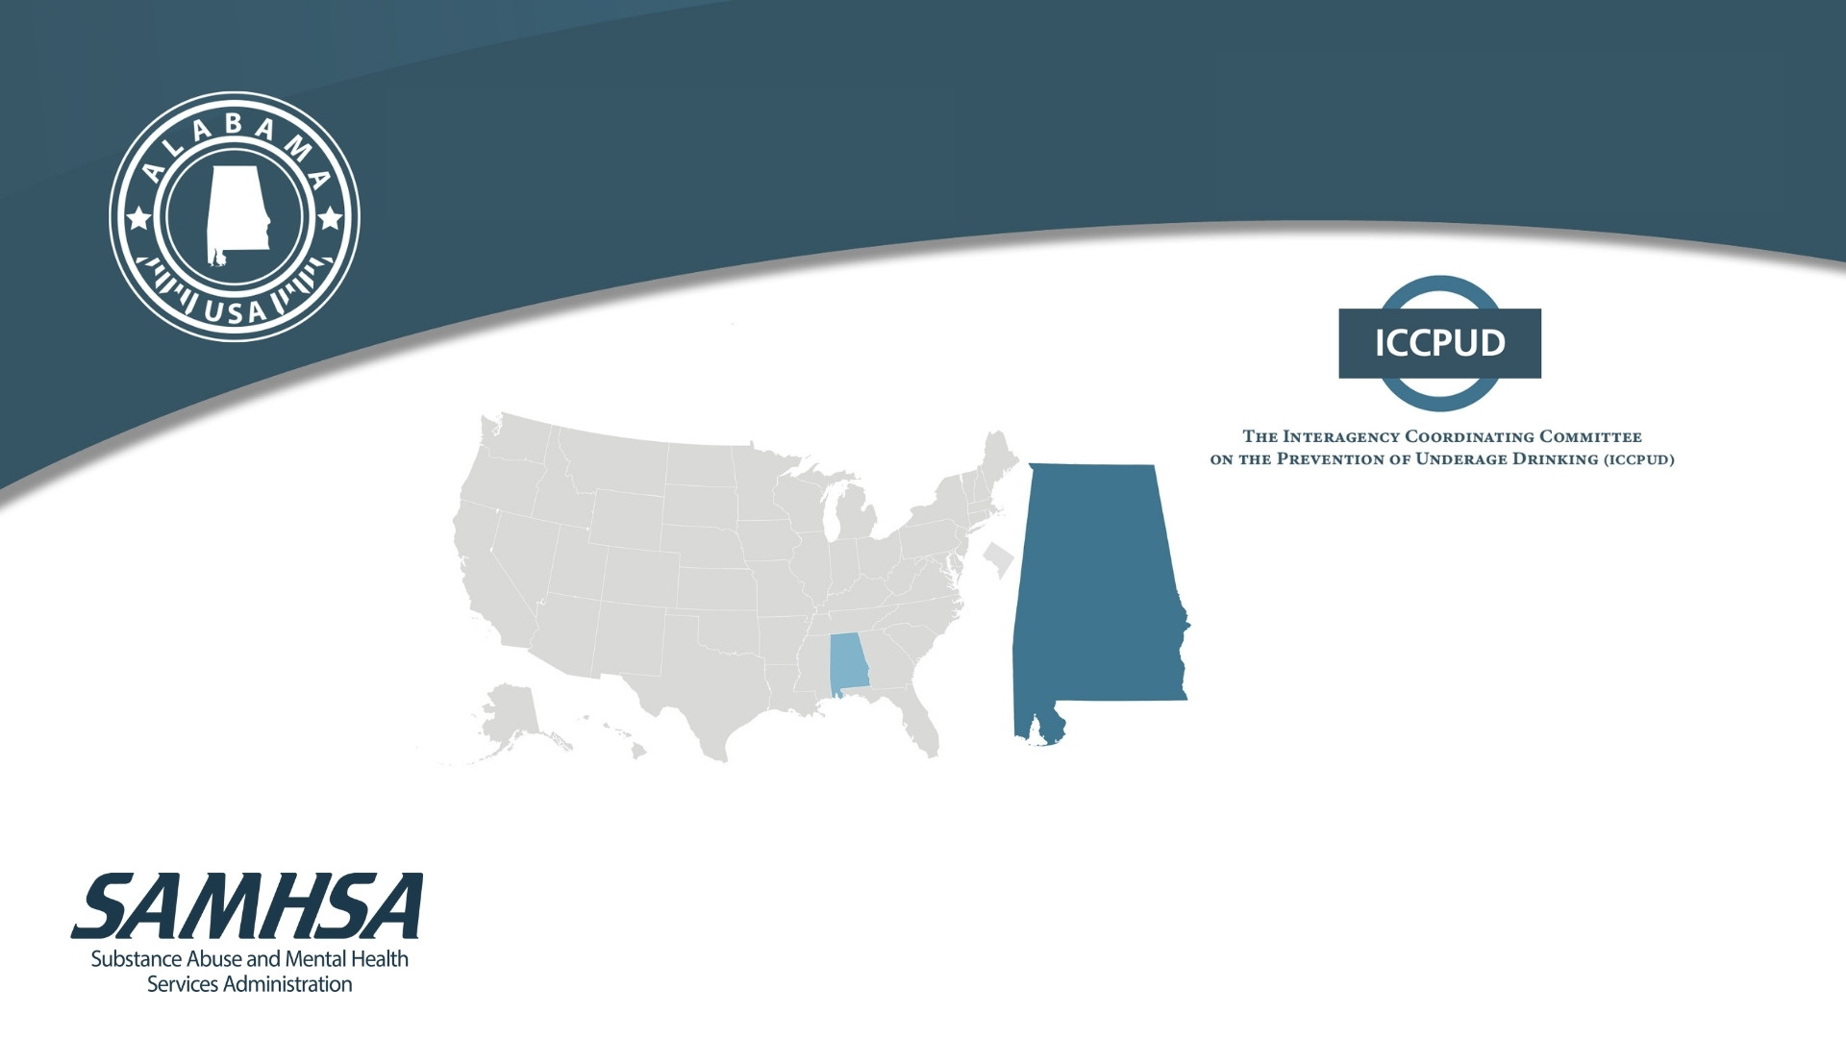
Report to Congress on the Prevention and Reduction of Underage Drinking
Alabama
This presentation draws on data contained in the 2021 Report to Congress on the Prevention and Reduction of Underage Drinking, the 2021 State Reports, and the 2021 State Performance & Best Practices for the Prevention and Reduction of Underage Drinking Report.
Notes:
This presentation describes some of the resources that have been developed under the Sober Truth on Preventing Underage Drinking Act (STOP Act). The STOP Act requires an annual Report to Congress on the Prevention and Reduction of Underage Drinking. It also requires individual State Reports for the 50 states and the District of Columbia. And third, it requires an annual report on State Performance & Best Practices for the Prevention and Reduction of Underage Drinking.
The introductory section of the presentation will briefly describe the general contents of the Report to Congress, highlighting some of the more important information appearing in the Report.
The main section focuses on the Alabama 2021 State Report, and includes highlights of underage drinking data, legal policies, enforcement, prevention activities, and expenditures, including data taken from Alabama’s responses to the 2020 STOP Act State Survey. It also includes national comparisons taken from the State Performance and Best Practices Report.
The Interagency Coordinating Committee for the Prevention of Underage Drinking, or ICCPUD, is responsible for the creation of these resources. The STOP Act established this committee of designated federal agencies to coordinate the federal approach to preventing underage drinking.

Slide 2
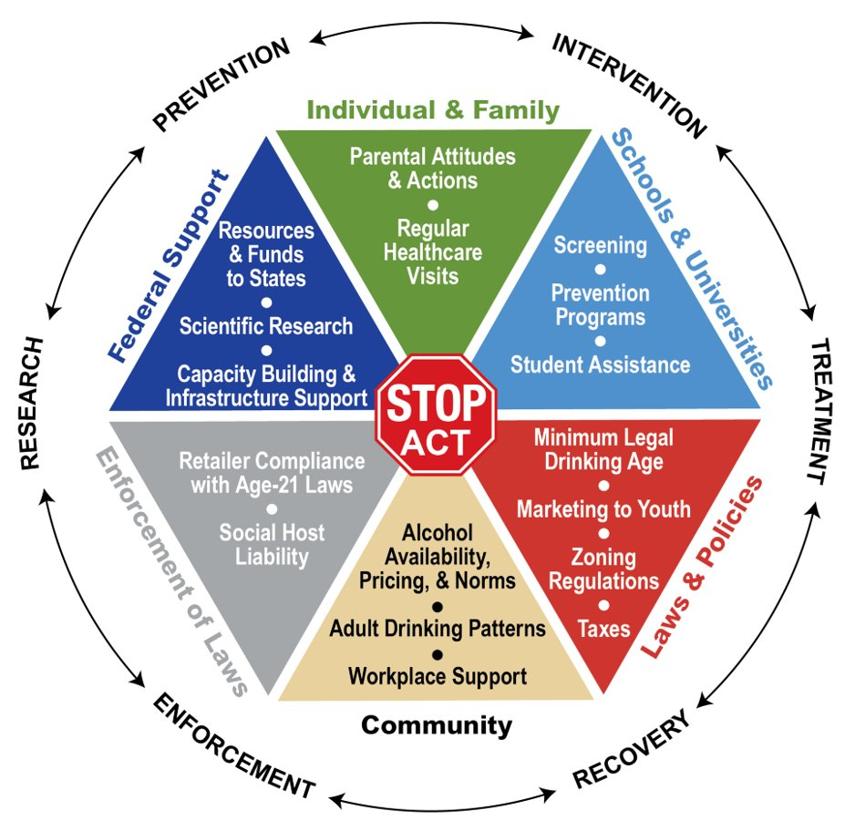
The Sober Truth on Preventing Underage Drinking Act
In 2006, Congress enacted the Sober Truth on Preventing Underage Drinking (STOP) Act (Public Law 109-422) to acknowledge that:
"A multi-faceted effort is needed to more successfully address the problem of underage drinking in the United States.
A coordinated approach to prevention, intervention, treatment, enforcement, and research is key to making progress."
Notes:
In 2006, Congress enacted the Sober Truth on Preventing Underage Drinking (STOP) Act (Public Law 109-422) to acknowledge that:
“A multi-faceted effort is needed to more successfully address the problem of underage drinking in the United States. A coordinated approach to prevention, intervention, treatment, enforcement, and research is key to making progress. This Act recognizes the need for a focused national effort, and addresses particulars of the Federal portion of that effort, as well as Federal support for State activities.”
Note that the STOP Act was reauthorized in 2016 as part of the 21st Century Cures Act.

Slide 3
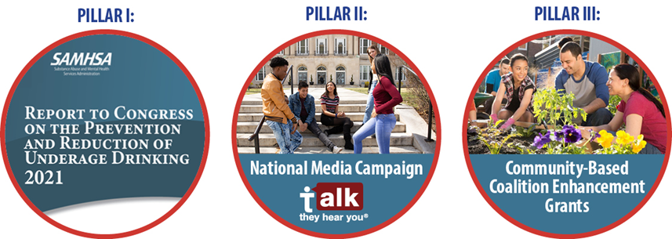
The Sober Truth on Preventing Underage Drinking Act, continued
Three Pillars of the STOP Act:
Notes:
The Sober Truth on Preventing Underage Drinking Act (the “STOP Act”) has three main components:
1. It requires an annual report to Congress on the national effort on preventing underage drinking
2. It requires annual reports “On each State’s performance in enacting, enforcing, and creating laws, regulations, and programs to prevent or reduce underage drinking.”
3. The STOP Act also requires:
The National Media Campaign--“Talk. They Hear You.”
Community-Based Coalition Enhancement Grants

Slide 4
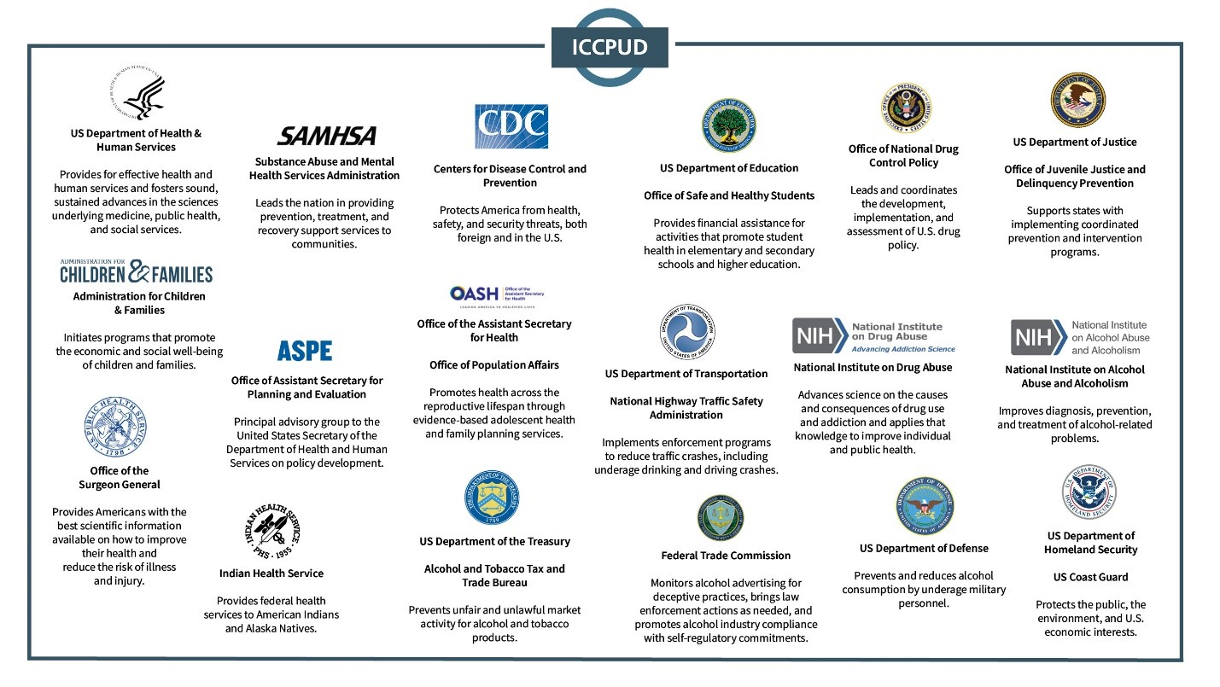
Coordinated Federal Approach
Interagency Coordinating Committee on the Prevention of Underage Drinking (ICCPUD)
4
Notes:
As specified in the STOP Act, the ICCPUD is composed of 16 federal officials, some of whom have delegated participation to specific agencies and/or staff:
the Secretary of Health and Human Services
the Secretary of Education
the Attorney General
the Secretary of Transportation
the Secretary of the Treasury
the Secretary of Defense
the Surgeon General
the Director of the Centers for Disease Control and Prevention
the Director of the National Institute on Alcohol Abuse and Alcoholism
the Administrator of the Substance Abuse and Mental Health Services Administration (now the Assistant Secretary for Mental Health and Substance Use, as designated in the 21st Century Cures Act)
the Director of the National Institute on Drug Abuse
the Assistant Secretary for Children and Families
the Director of the Office of National Drug Control Policy
the Administrator of the National Highway Traffic Safety Administration
the Administrator of the Office of Juvenile Justice and Delinquency Prevention
the Chairman of the Federal Trade Commission
While not enumerated in the (STOP) legislation, other agencies have chosen to participate. There are currently 22 federal departments and agencies participating in the ICCPUD.
Chapter 2 and Appendix B of the Report to Congress include detailed descriptions of each of these agency’s efforts to prevent and reduce underage drinking.
ICCPUD consults and collaborates with all appropriate and interested parties, including state and local governments, public health research and interest groups, foundations, community-based organizations and coalitions, and alcohol beverage industry trade associations and companies.
Thirty-four (67 percent) of the states have a state-level interagency committee to coordinate underage drinking prevention activities.

Slide 5
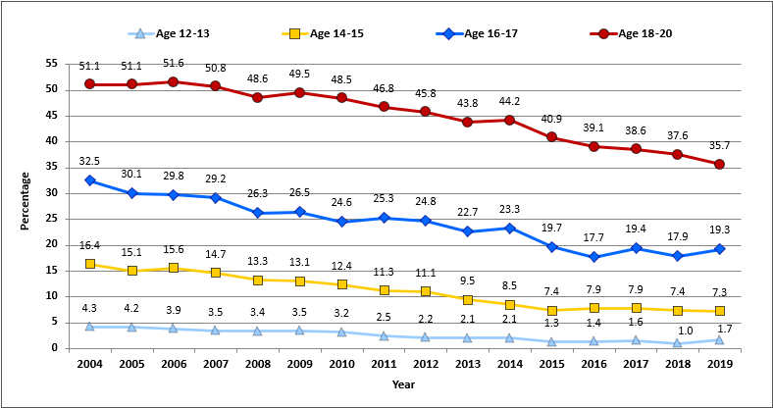
Data on Prevalence & Patterns of Underage Drinking
Trends in Past-Month Alcohol Use for 12- to 20-Year-Olds by Age Group: 2004–2019
5
Notes:
Data on this chart were obtained from the 2019 National Survey on Drug Use and Health conducted by SAMHSA's Center for Behavioral Health Statistics and Quality.
The 2021 Report to Congress documents ongoing local, state, and federal efforts to prevent and reduce underage drinking:
Among Americans under age 21, alcohol is the most frequently used substance, used more often than tobacco, marijuana, or other illicit drugs.
Underage alcohol consumption is a persistent and serious public health challenge, resulting in thousands of deaths each year through motor vehicle crashes, violence, suicide, alcohol poisoning, and other causes.
National epidemiologic data demonstrate that national and state prevention efforts are having positive effects. Local and community-level activity, which is not generally measured, is also contributing.
Since 2004, past-month alcohol use by underage drinkers has declined by 35.5 percent.
Past-month use by young adults (ages 18-20) remains at a high level, although (as illustrated in this chart), some decline is evident since 2014.

Slide 6
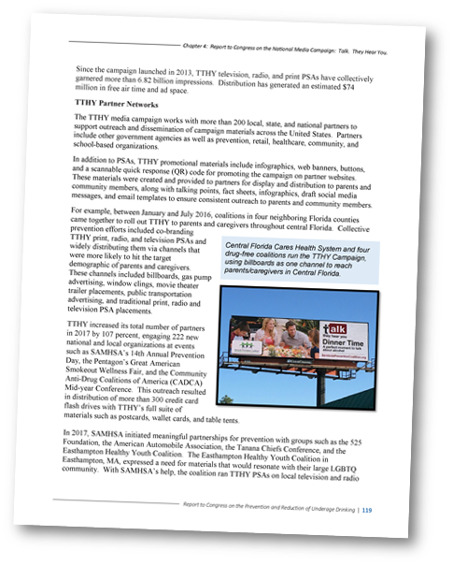
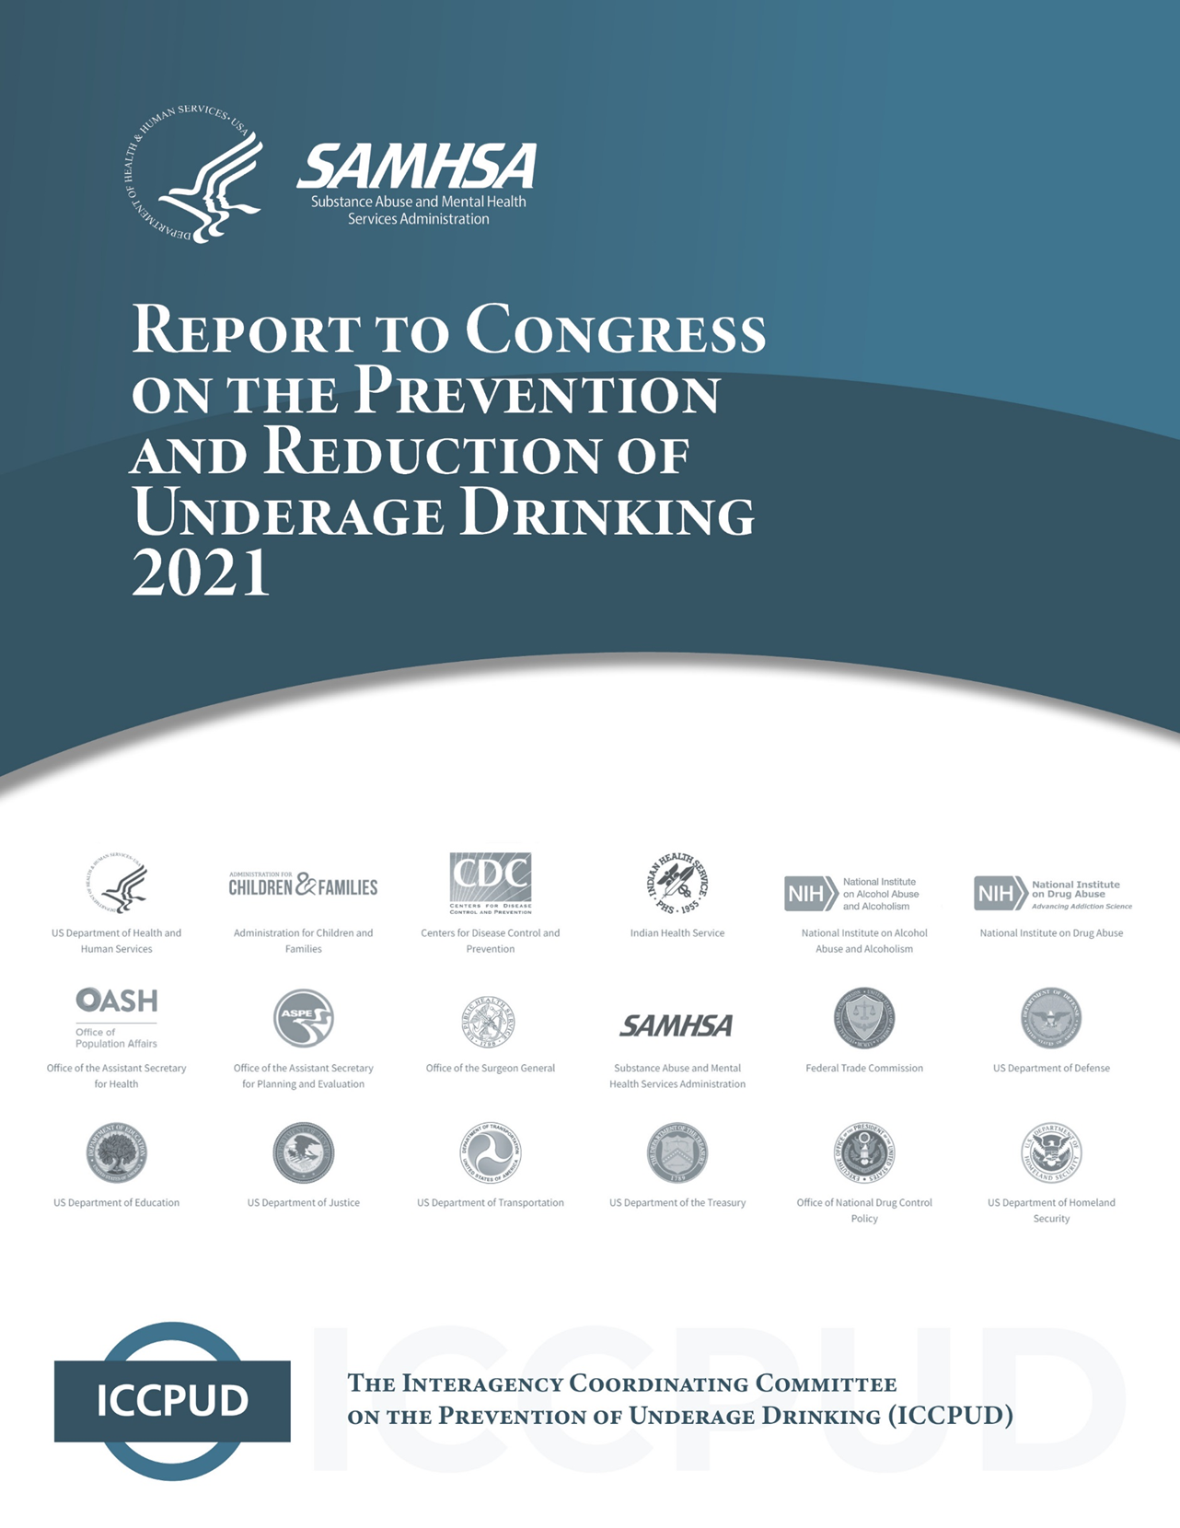
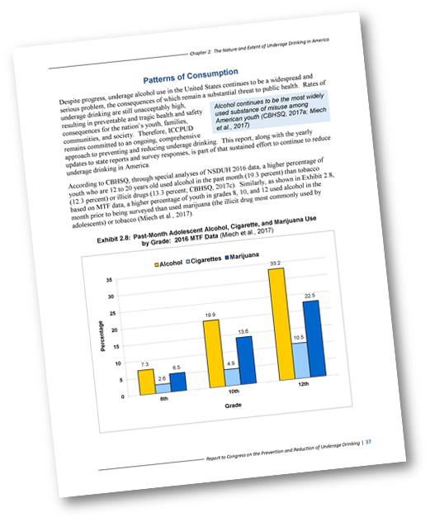
STOP Act Annual Report to Congress
Federally coordinated approach on underage drinking
National data on underage drinking patterns
National Media Campaign – “Talk. They Hear You.”
Available at: https://www.stopalcoholabuse.gov
Notes:
The STOP Act requires the annual Report to Congress on the Prevention and Reduction of Underage Drinking, which includes information on:
National data on the prevalence and patterns of underage drinking
The federally coordinated approach to underage drinking prevention, with a description of programs and policies
A report on the national adult-oriented media public service campaign required by the STOP Act known as “Talk. They Hear You.”
The Report to Congress is available at the URL shown.

Slide 7
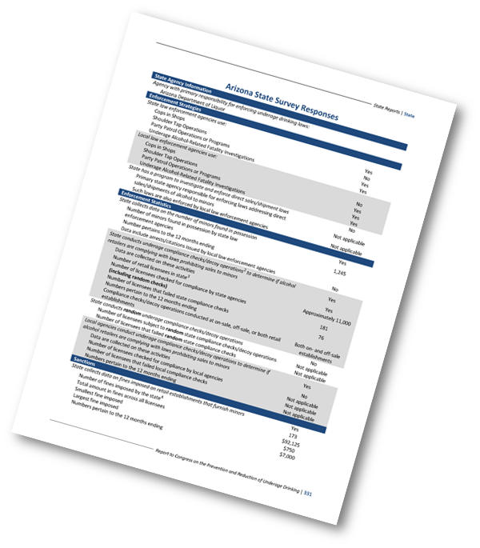
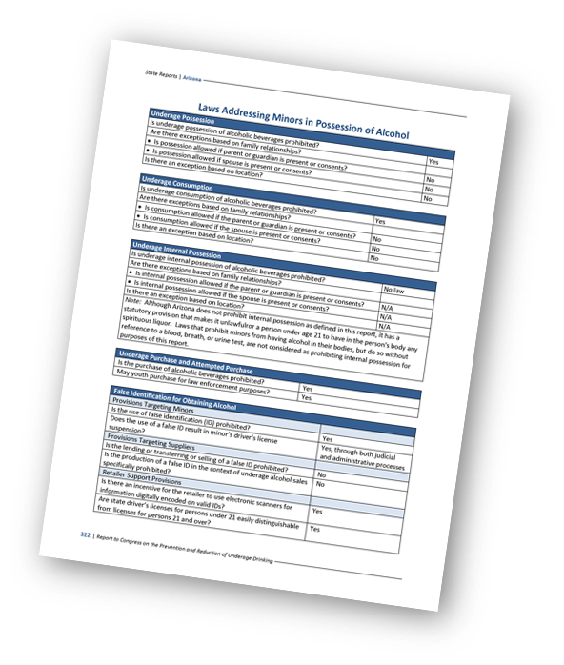
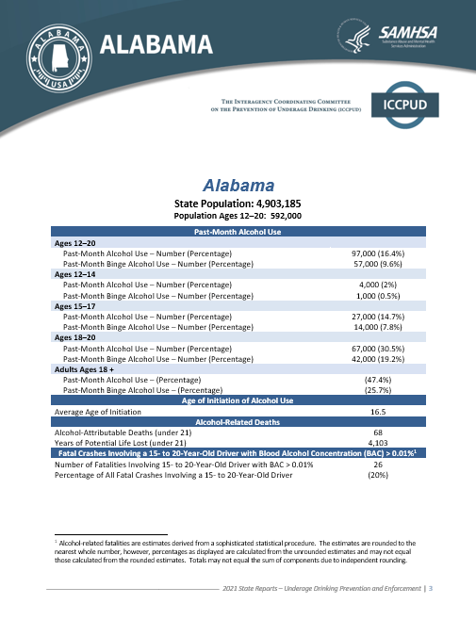
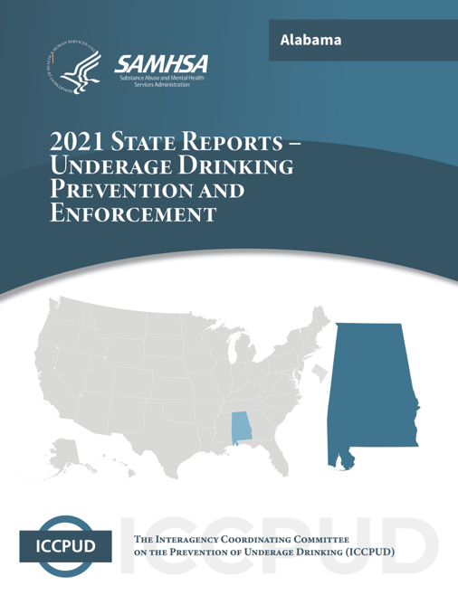
STOP Act State Reports
Underage drinking data
Laws, programs, and practices
Prevention and treatment system
Enforcement & prevention data
Available at: https://www.stopalcoholabuse.gov
Notes:
The STOP Act requires individual reports for the 50 states and the District of Columbia. Each report contains state-specific data on underage and adult drinking rates; description of state's prevention and treatment system; state laws and policies identified as best or potential best practices for preventing underage drinking; and annual State Survey responses, including prevention programs, collaborations and best practices, expenditures, and enforcement.

Slide 8
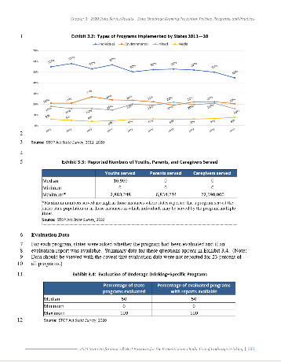
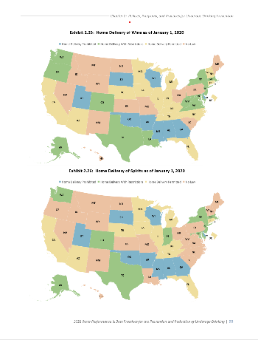
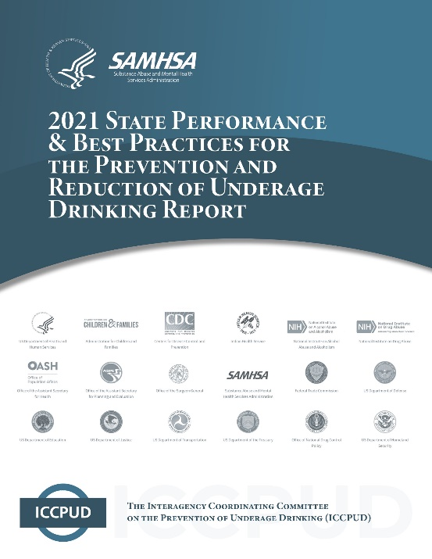
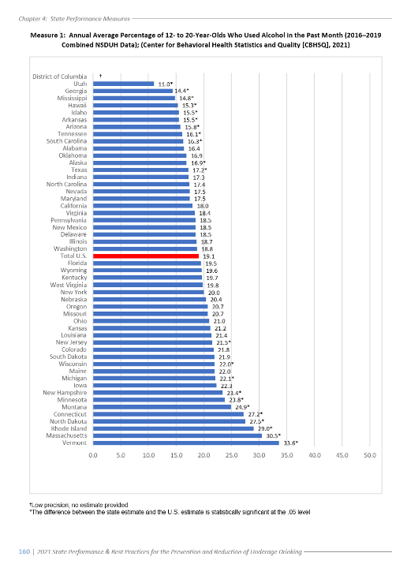
STOP Act State Performance & Best Practices
Evidence-based and promising policies and practices
Analysis of state survey data on prevention & enforcement activities and expenditures
States’ performance on 9 underage drinking prevention & treatment measures
Available at: https://www.stopalcoholabuse.gov
Notes:
The SPBP:
Describes best practices and evidence-based policies (EBPs) for underage drinking reduction and prevention;
Helps states prepare to prevent underage drinking by understanding EBPs and each state’s performance in reducing underage drinking;
Compares states’ performance in implementing EBPs to reduce underage drinking;
Provides data on state enforcement of underage drinking laws and prevention programs.

Slide 9
State Reports – Overview
Population data
Adult and underage drinking rates
9
Notes:
The STOP Act requires annual reports on each state's efforts to prevent and reduce underage drinking.
Each State Report contains:
- Population data and adult and underage drinking rates.

Slide 10
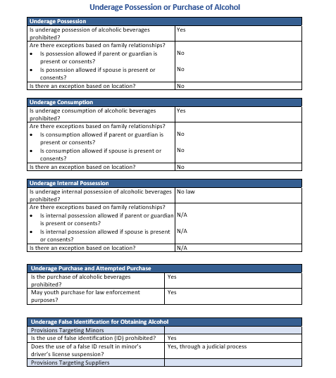
State Reports – Policies, Programs, and Practices
Includes data on 26 underage drinking prevention policies, programs, and practices
10
Notes:
Each state report includes data on 26 underage drinking policies, programs, and practices in 6 main categories:
1. Underage possession or purchase of alcohol
-Underage possession
-Underage consumption
-Internal possession by minors
-Underage purchase and attempted purchase
-False identification
2. Underage Drinking and Driving
-Youth blood alcohol concentration (BAC) limits
-Loss of driving privileges for alcohol violations by minors
-Graduated driver’s licenses
3. Alcohol Availability
-Furnishing of alcohol to minors
-Responsible beverage service
-Minimum ages for off-premises sellers
-Minimum ages for on-premises servers and bartenders
-Outlet siting near schools
-Dram shop liability
-Social host liability
-Hosting underage drinking parties
-Keg registration
-High-proof grain alcoholic beverages
4. Sales and Delivery to Consumers at Home
-Retailer interstate shipment
-Direct sales/shipments
-Home delivery
5. Alcohol Pricing
-Alcohol taxes
-Drink specials
-Wholesale pricing
6. Enforcement Policies
-Compliance check protocols
-Penalty guidelines for sales to minors

Slide 11
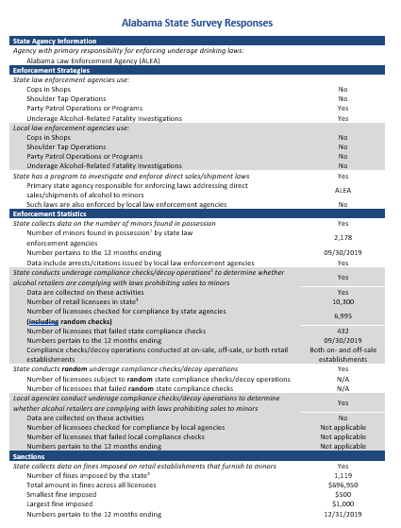
State Reports – State Survey
Includes data on:
Enforcement activities
Prevention programs
Best practices & collaborations
State expenditures
11
Notes:
Each state report includes data collected by the annual STOP Act State Survey, including:
Enforcement of underage drinking laws
Prevention programs
Best practices & collaborations to prevent and reduce underage drinking
State expenditures for the prevention of underage drinking

Slide 12
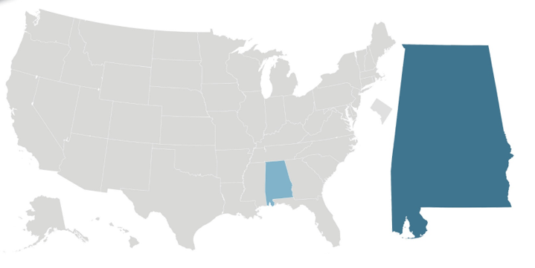
Alabama State Report
12
Notes:
The following slides offer highlights from the Alabama State Report.
To put the Alabama data into context, comparable data at the national level are provided.

Slide 13
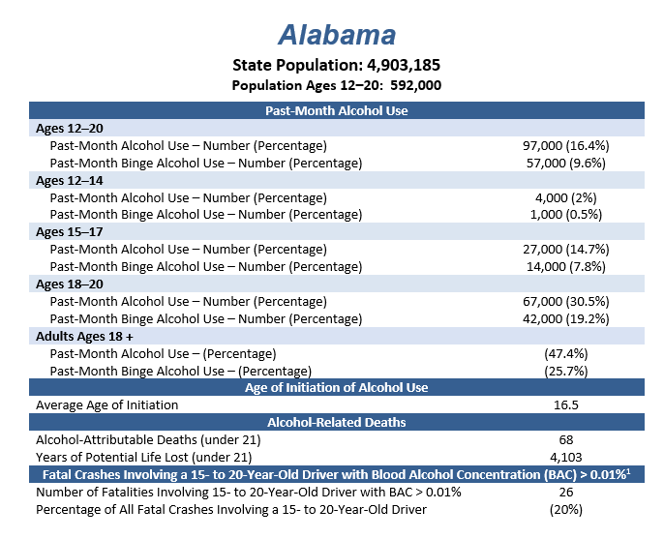
Alabama State Profile
13
Notes:
Alabama population data and adult and underage drinking rates

Slide 14

Alabama and U.S. - Past Month Underage Alcohol Use
Past Month Underage Alcohol Use (%):
Ages 12 to 20 (2010-2019)
Alabama
U.S.
14
Notes:
Data on this chart were obtained from special analyses of the National Survey on Drug Use and Health by SAMHSA's Center for Behavioral Health Statistics and Quality, 2010-2019.
Past month underage alcohol use from Alabama and nationally, 2010 to 2019.

Slide 15
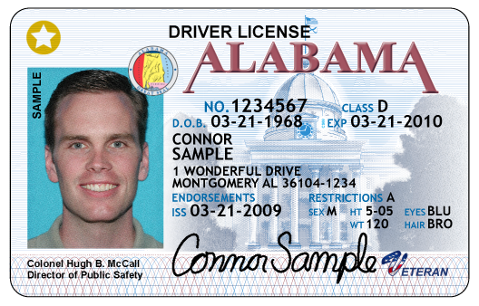
Alabama Underage False IDs Policy
POLICY EXAMPLE 1: Underage False IDs
In Alabama:
Use of false ID is prohibited
Use results in suspension of driver’s license through judicial process
Retailer may not detain youth who uses false ID
15
Notes:
This slide shows a description of Alabama’s policy addressing the use of false ID for obtaining alcohol.
Each state report contains summary descriptions of 26 underage drinking prevention policies, programs, and practices (as described previously).
Each policy has been analyzed using a number of variables for comparison purposes.

Slide 16
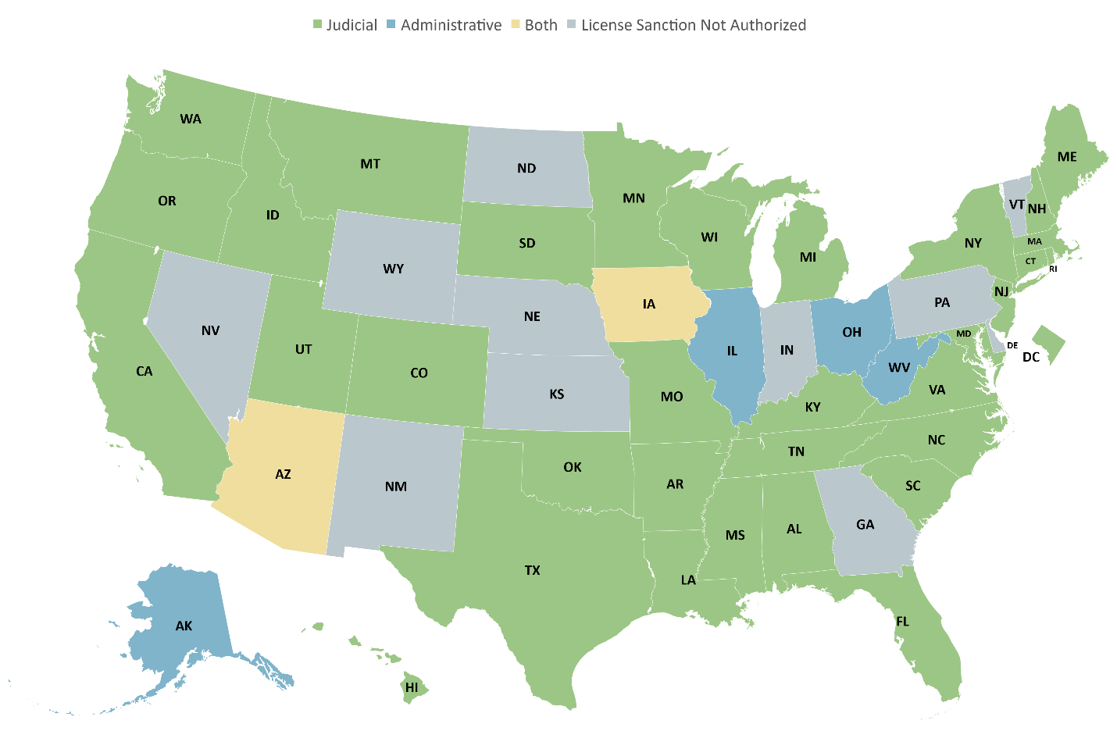
All States - Underage False IDs Policy
POLICY EXAMPLE 1: Underage False IDs
Procedure for Imposing License Sanction for Use of False ID as of January 1, 2020
16
Notes:
This is the national picture of false ID laws, found in Chapter 2 of the State Performance & Best Practices (Policies, Programs, and Practices for Underage Drinking Prevention).

Slide 17
Alabama “Use/Lose” Policy
POLICY EXAMPLE 2: “Use/Lose”
In Alabama:
Mandatory that the license of a driver under age 21 be suspended or revoked for 90-180 days for:
Purchasing alcohol
Possessing alcohol
Consuming alcohol
17
Notes:
Some laws target underage drinking and driving.
This slide describes Alabama’s “use/lose” law—the law that suspends or revokes a minor’s driving privileges for alcohol violations.

Slide 18
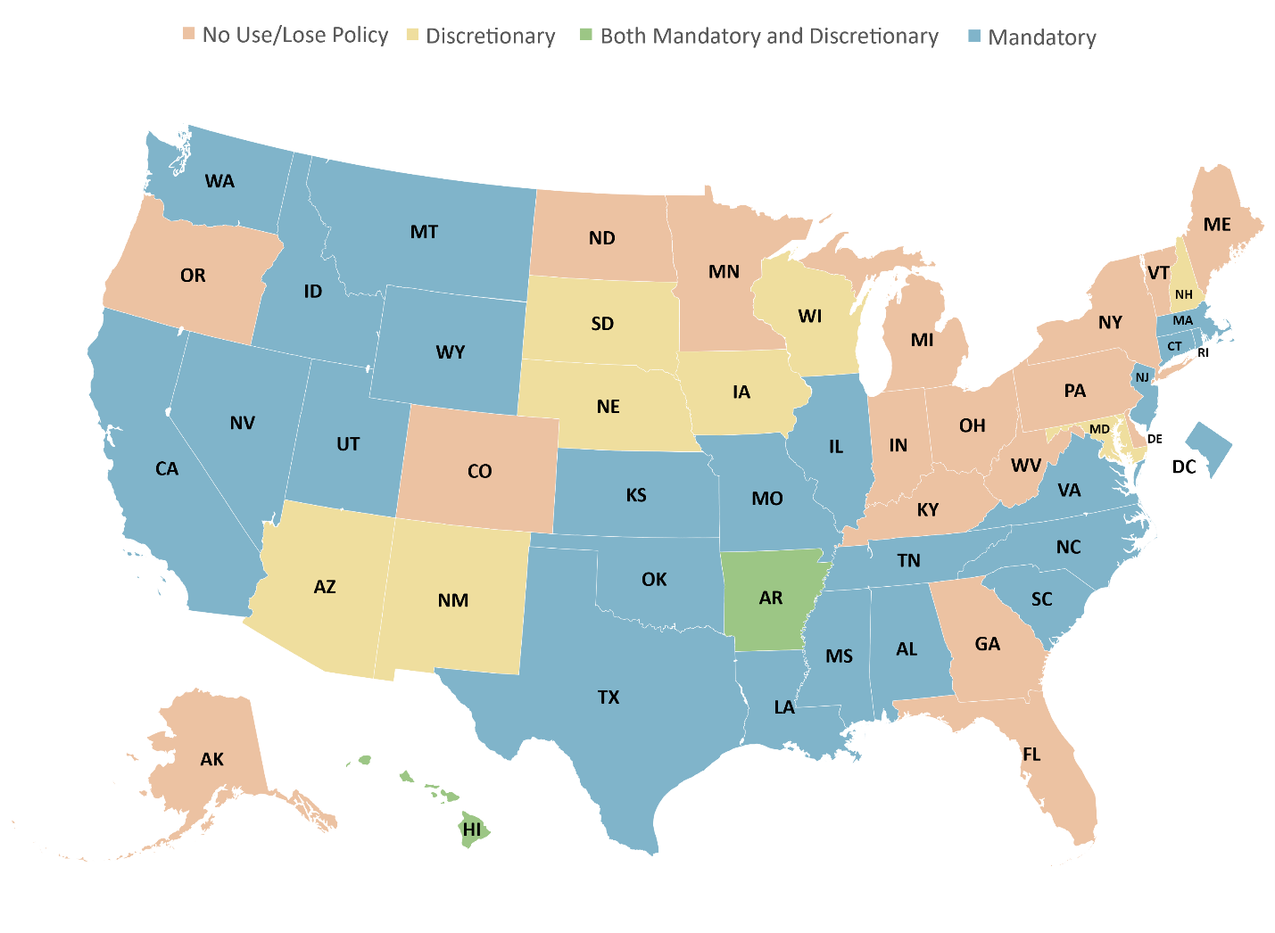
All States - “Use/Lose” Policy
POLICY EXAMPLE 2: “Use/Lose”
License Suspension/Revocation for Alcohol Violations by Minors
as of January 1, 2020
18
Notes:
This is the national picture of “use/lose” laws, found in Chapter 2 of the State Performance & Best Practices (Policies, Programs, and Practices for Underage Drinking Prevention).

Slide 19
Alabama Minimum Age for Alcohol Servers Policy
POLICY EXAMPLE 3: Minimum Age for Alcohol Servers
In Alabama:
Servers must be at least 19 to serve alcohol in on-premises establishments
Bartenders must be at least 21 to serve alcohol in on-premises establishments AND a manager/supervisor must be present
19
Notes:
A number of the 26 policies are laws that target alcohol suppliers.
This slide describes Alabama’s laws governing the minimum age for alcohol servers and bartenders in on-premise establishments.

Slide 20
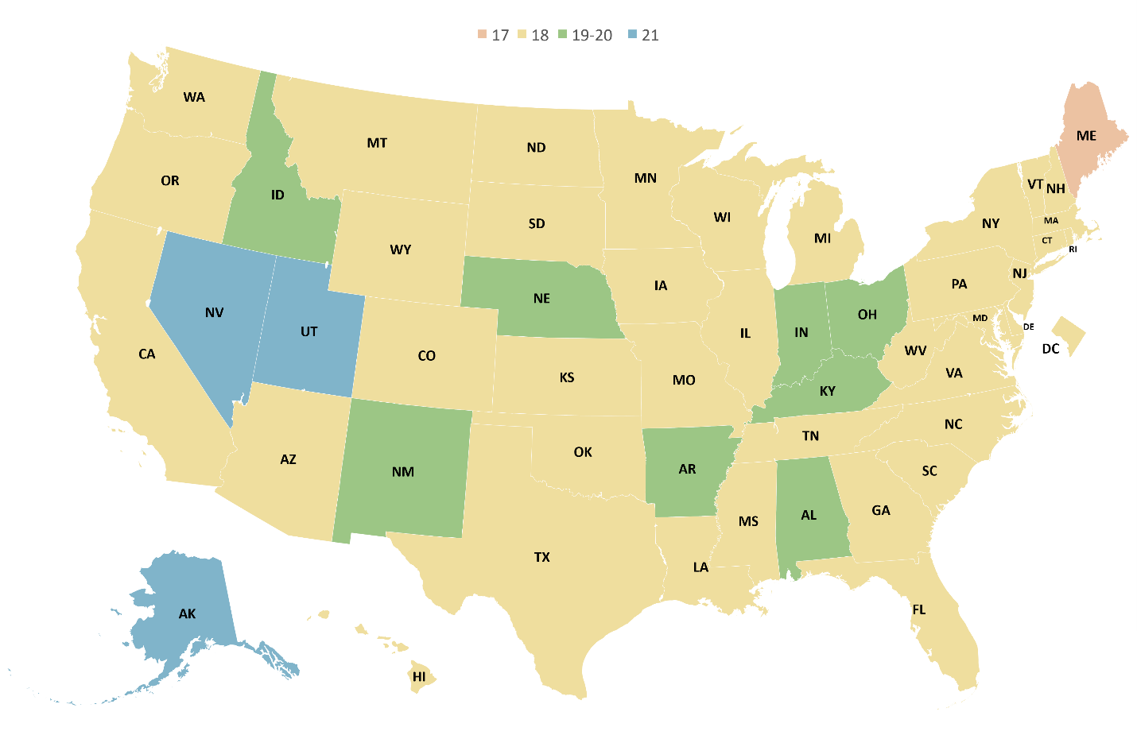
All States - Minimum Age for Alcohol Servers Policy
POLICY EXAMPLE 3: Minimum Age for Alcohol Servers
Minimum Ages for On-Premise Servers (Beer) as of January 1, 2020
20
Notes:
Minimum ages for on-premise servers of beer across the nation, found in Chapter 2 of the State Performance & Best Practices (Policies, Programs, and Practices for Underage Drinking Prevention).

Slide 21
Alabama Enforcement – State Compliance Checks
ENFORCEMENT EXAMPLE 1:
Percentage of Licenses Checked
Alabama conducts underage compliance checks/ decoy operations to determine if alcohol retailers are complying with laws prohibiting sales to minors
Alabama checked:
6,995 retail licenses (out of 10,300 total), or
68 percent of all licenses
21
Notes:
This and the following slides discuss Alabama’s (and all states) responses to the 2020 STOP Act State Survey. Most data reported in the 2020 survey are from 2019.
The first section of the survey includes questions about each state’s enforcement of underage drinking laws, including strategies employed, compliance checks (both state and local), minors in possession arrests, sanctions against retailers (fines, suspensions, revocations), and enforcement of direct sales/shipment of alcohol laws.
•To determine if alcohol retailers are complying with laws prohibiting sales to minors, states (including Alabama) conduct compliance checks.
•Compliance checks (or decoy operations) are defined as those enforcement actions in which trained underage (or apparently underage) operatives (“decoys”), working with law enforcement officials, enter retail alcohol outlets and attempt to purchase alcohol.
This slide examines Alabama’s responses to the survey regarding state compliance checks:
Alabama conducts underage compliance checks/ decoy operations to determine if alcohol retailers are complying with laws prohibiting sales to minors
Alabama checked:
6,995 retail licenses (out of 10,300 total), or 68 percent of all licenses
Note that this data includes only compliance checks conducted at the state level, not the local level.

Slide 22
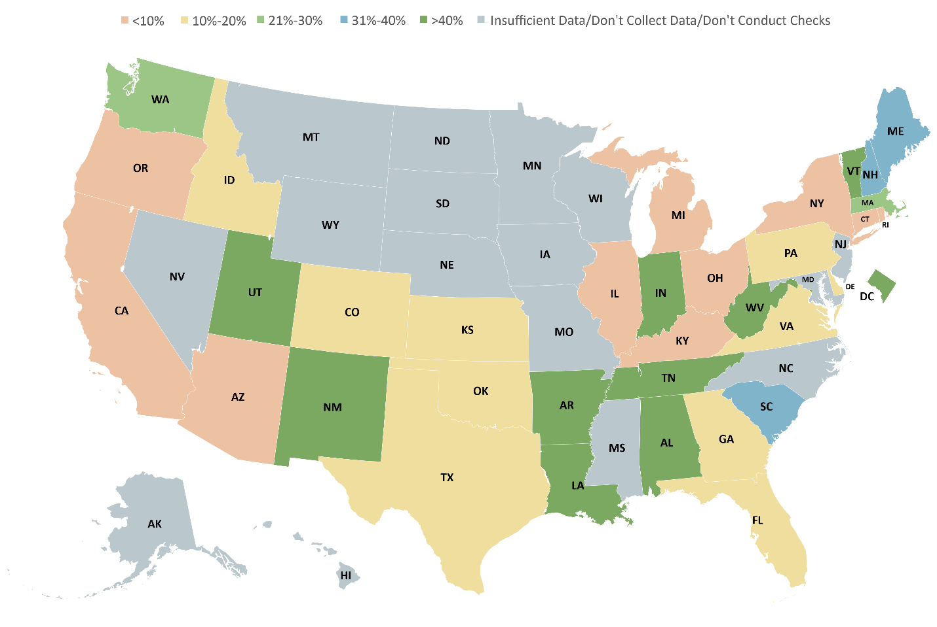
All States Enforcement – State Compliance Checks
ENFORCEMENT EXAMPLE 1:
Percentage of Licenses Checked
22
Notes:
This map provides a state-by-state picture of the percentage of licensees checked, as reported in the 2020 STOP Survey.
Fifty-seven percent of those states conducting checks tested 20 percent or fewer of their licensees, indicating that checking is generally not comprehensive.
A median of 17 percent of licensed establishments were checked across all states that conduct these checks.
Note that these are compliance checks performed at the state level, not local level.

Slide 23
Alabama Enforcement – Compliance Check Failure Rates
ENFORCEMENT EXAMPLE 2:
Compliance Check Failure Rates
Of the 6,995 retail licenses checked by Alabama in 2019, 432 (or 6 percent) failed
Compliance checks were conducted at both on- and off-sale establishments
23
Notes:
Of the 6,995 retail licenses checked by Alabama in 2019, 432 (or 6 percent) failed
Compliance checks were conducted at both on- and off-sale establishments

Slide 24
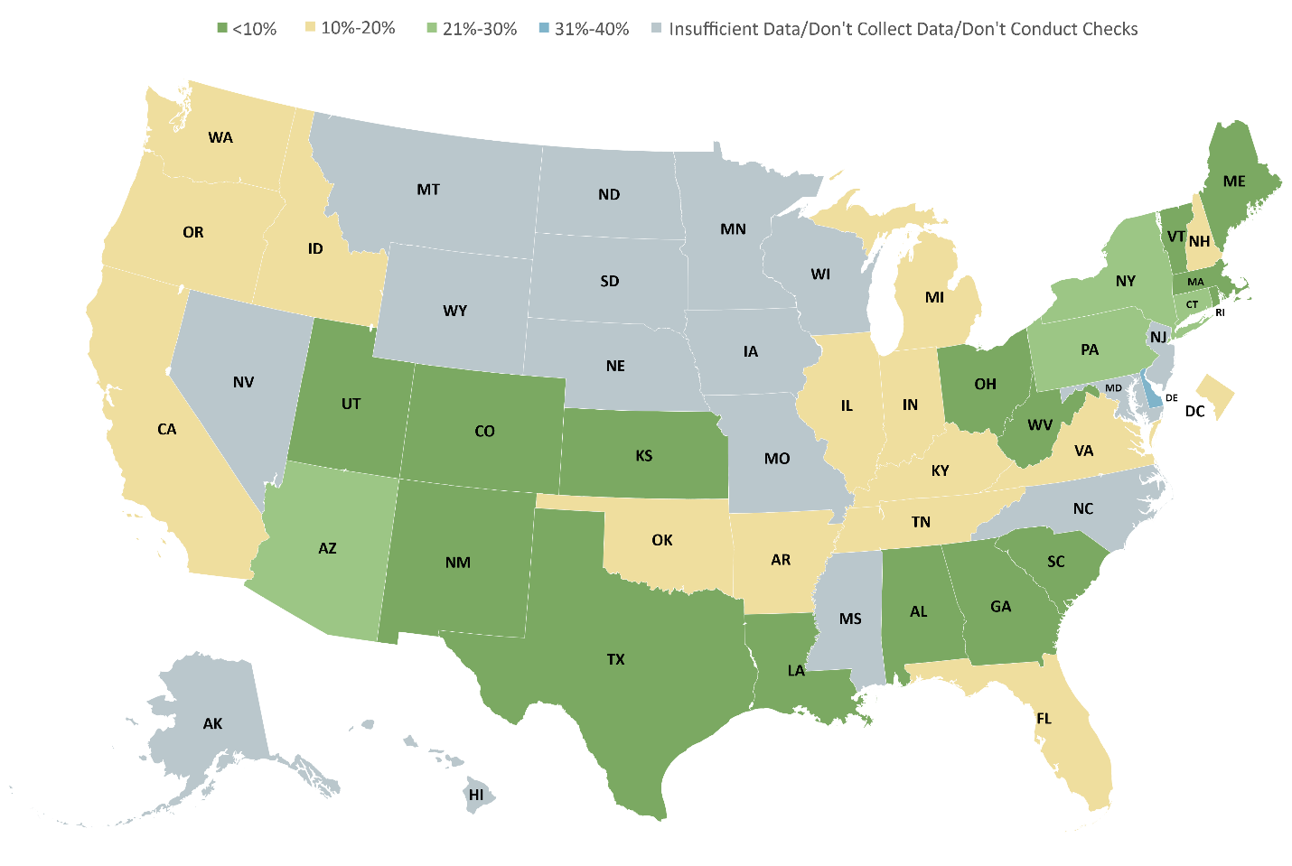
All States Enforcement – Compliance Check Failure Rates
ENFORCEMENT EXAMPLE 2: Compliance Check Failure Rates
24
Notes:
This map provides a state-by-state picture of licensee failure rates for all compliance checks conducted by state agencies, as reported in the 2020 STOP Survey.
Most state-level checks report failure rates of 20 percent or less, with 5 states reporting higher rates.
A median of 11 percent of licensed establishments failed compliance checks in all states.

Slide 25
Alabama and All States Enforcement – Sanctions/Fines
ENFORCEMENT EXAMPLE 3:
Sanctions/Fines for Furnishing Alcohol to People <21
Alabama imposed 1,119 fines
Smallest fine: $500
Largest fine: $1,000
All states imposed a median of 159 fines
Smallest fine: $0
Largest fine: $80,000
25
Notes:
Fines are among the sanctions that can be taken against retailers in violation of underage alcohol consumption policies. Data on this slide reflect Alabama’s responses to questions regarding fines, compared to figures from all states. Note that $0 may be reported as the smallest fine imposed if a licensee serves a suspension period.

Slide 26
Alabama State System for Prevention and Treatment
Alabama Prevention and Treatment System
26
Notes:
Description of Alabama’s Prevention and Treatment System, extracted from FY 2020/2021 – (Alabama) State Behavioral Health Assessment and Plan, Substance Abuse Prevention and Treatment Block Grant (SABG), Center for Substance Abuse Prevention (CSAP), Division of State Programs, Center for Substance Abuse Treatment (CSAT), Division of State and Community Assistance: B. Planning Steps, 1. Assess the strengths and organizational capacity of the service system to address the specific populations.

Slide 27
Alabama Best Practice Standards
Alabama has adopted or developed best practice standards for underage drinking prevention programs
27
Notes:
States are asked if they have adopted or developed best practice standards for underage drinking prevention programs, and which agencies or organizations have established these best practice standards: Federal agency(ies), agency(ies) within their state; nongovernmental agency(ies), or other organizations or agencies.
Forty-five states (88 percent), reported that they had adopted or developed best practice standards.
Alabama has adopted or developed best practice standards for underage drinking prevention programs.

Slide 28
Alabama Underage Drinking Prevention Programs
Underage Drinking Prevention Programs Operated or Funded by Alabama
Drug Education Council
Alcohol and Drug Abuse Treatment Center, Inc.
Aletheia House
The Mountain Lakes Behavioral Healthcare Substance Abuse Prevention Program
Wellstone Behavioral Health
Agency for Substance Abuse Prevention
Northwest Alabama Mental Health Center
East Alabama Mental Health Center
Altapointe Health Systems
Mental Health Center of North Central Alabama/Quest Recovery Center
Council on Substance Abuse-National Council on Alcoholism and Drug Dependency (COSA-NCADD) Council on Substance Abuse-National Council on Alcoholism and Drug Dependency (COSA-NCADD)
SpectraCare Health Systems
Parents Resource Institute Drug Education (PRIDE)
South Central Alabama Mental Health Center (SCAMHC)
28
Notes:
States were asked to list general prevention programs that have underage drinking as one objective and are funded or operated directly by the state.
Alabama reported the programs listed here.

Slide 29
Alabama Underage Drinking Prevention Programs, continued
Alabama Prevention Program Example
29
Notes:
States were also asked:
The number of youth, parents, and caregivers served by each program (if the program was aimed at a specific, countable population)
If the program has been evaluated
If an evaluation report is available and where the report can be found
This slide shows Alabama’s responses for one of its prevention programs.

Slide 30
Alabama Interagency Governmental Committee
Alabama has a state-level interagency governmental committee to coordinate underage drinking prevention activities
Agencies/organizations represented on Alabama’s committee:
Substance Abuse and Mental Health Services Administration
Agency for Substance Abuse Prevention
Alabama Department of Corrections
Alabama State Department of Education
Auburn University at Montgomery
Drug Education Council
Alabama Department of Human Resources
Alabama Department of Public Health
Alabama State University
University of Alabama Tuscaloosa
COMPACT2020
Healthy Sexual Solutions, LLC
Family Guidance Center
Addiction Prevention Coalition
Council on Substance Abuse
Cherokee, Etowah, Dekalb Mental Health Center
SpectraCare Health Systems
Medical Advocacy and Outreach
Franklin Primary Health Center, Inc.
AIDS Alabama
Alabama Children's Policy Council
Mental Health Center of North Central Alabama
Alabama Administrative Office of Courts
Parent Resource Institute for Drug Education
Sylacauga Alliance for Family Enhancement
30
Notes:
States are asked if they have a state-level interagency governmental committee to coordinate underage drinking prevention activities, and if so, which agencies or organizations are represented on their committee.
Thirty-four states (67 percent), including Alabama, reported that such a committee exists, although the composition of the committee varied somewhat from state to state.
Alabama has a state-level interagency governmental committee to coordinate underage drinking prevention activities.
Agencies/organizations represented on Alabama’s committee are listed on this slide.

Slide 31
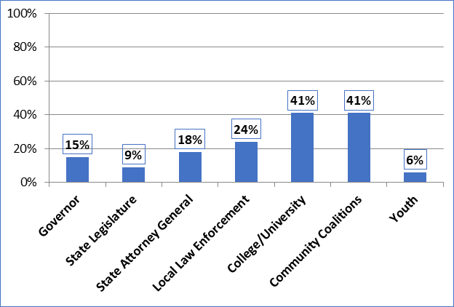
All States: Interagency Governmental Committee
Composition of the State Interagency Group: Percentage of States with Representatives from Government or Other Entities
31
Notes:
Most states’ interagency committees included a variety of state agencies directly involved in underage drinking prevention policy implementation and enforcement, as well as educational and treatment program development and oversight.
Of interest is the extent to which the committees included representatives from the governor’s office, state legislature, and office of the state attorney general, given that they are so critical in setting priorities, providing funding, and generating political and public support.
Forty-one percent of the states with interagency committees included college/university administrations, campus life departments, or campus police, and 41 percent included community coalitions or concerned citizens.
About one in four states included local law enforcement, and 6 percent included youth.

Slide 32
Alabama: Expenditures for Prevention of Underage Drinking
Alabama responded to questions on state expenditures as follows:
Compliance checks in retail outlets: $20,419.65
Checkpoints and saturation patrols: Not applicable
Community-based programs: Data not available
K–12 school-based programs: Data not available
Institutes of higher learning programs: Data not available
Juvenile justice system programs: Data not available
Child welfare system programs: Data not available
Other underage drinking programs: Data not available
32
Notes:
The STOP Act specifies state expenditures on the prevention of underage drinking as a performance measure.
Expenditures are to be broken out by the amount spent on enforcement activities (compliance checks, checkpoint and saturation patrols) and programs targeted to youths, parents, and caregivers (community based, K-12, higher education, juvenile justice, and child welfare), as well as “other” programs intended to prevent or reduce underage drinking.
Alabama reported the following expenditures on the 2020 STOP Act State Survey:
Compliance checks in retail outlets: $20,419.65
Data were not available for Alabama to report on other expenditures
Among all states, the largest expenditure category is for community-based programs, followed by K–12 school programs.
The median of expenditures for programs targeted to youth, parents, and caregivers ($183,722) is 10 times that for all enforcement activities (median = $18,388), and the total dollar amount expended for these nonenforcement programs ($141,086,470) is 20 times the total dollar amount spent on enforcement ($7,015,726).

Slide 33
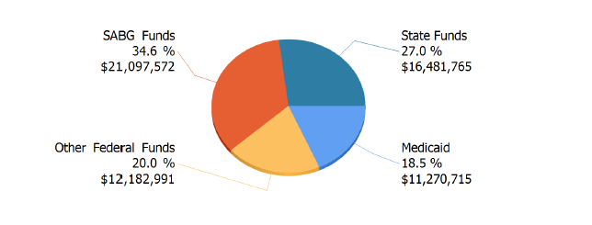
Alabama: Prevention and Treatment Funding and Priorities
Alabama’s #1 priority for use of SABG funds FY 2020-2021: Prevention of underage drinking
Source of 2020 Expenditures for Substance Abuse Prevention and Treatment
33
Notes:
In addition to the state expenditures on underage drinking prevention reported in the annual STOP Act State Survey, all states receive federal funds for substance abuse prevention through Substance Abuse Prevention and Treatment Block Grant (SABG) funds, administered by the Substance Abuse and Mental Health Services Administration (SAMHSA).
This chart shows the sources that Alabama used for expenditures on substance abuse prevention and treatment. As indicated, SABG funds and state funds account for the largest sources (34.6 percent and 27.0 percent, respectively).
States submit Behavioral Assessment and Plan reports that include their priorities for use of SABG funds, as well as planned expenditures. For FY 2020–2021, Alabama designated the prevention of underage drinking as the number one priority for use of SABG funds.
Sources:
WebBGAS State Profile, 2020 SABG and MHBG Reports– Alabama 2020
FY 2020/2021 – (Alabama) State Behavioral Assessment and Plan, Substance Abuse Prevention and Treatment Block Grant, Center for Substance Abuse Prevention, Division of State Programs, Center for Substance Abuse Treatment, Division of State and Community Assistance, Table 1: Priority Areas and Annual Performance Indicators

Slide 34
For Further Information:
Thank you!
To view or download the Report to Congress on the Prevention and Reduction of Underage Drinking, the State Performance and Best Practices, and the State Reports, please visit:
https://www.stopalcoholabuse.gov
For questions about this presentation or for further information about your state’s underage drinking prevention efforts, contact: _______________________
For questions about the resources above, or for further information about national efforts to prevent underage drinking, send an email to underagedrinking@samhsa.gov
34
Notes:
Thank you! For further access to the Report to Congress, the State Performance and Best Practices, and/or your state’s report, visit the above URL.
If you have additional questions about state or national underage drinking prevention efforts, please get in touch with the contacts listed here.

Slide 35
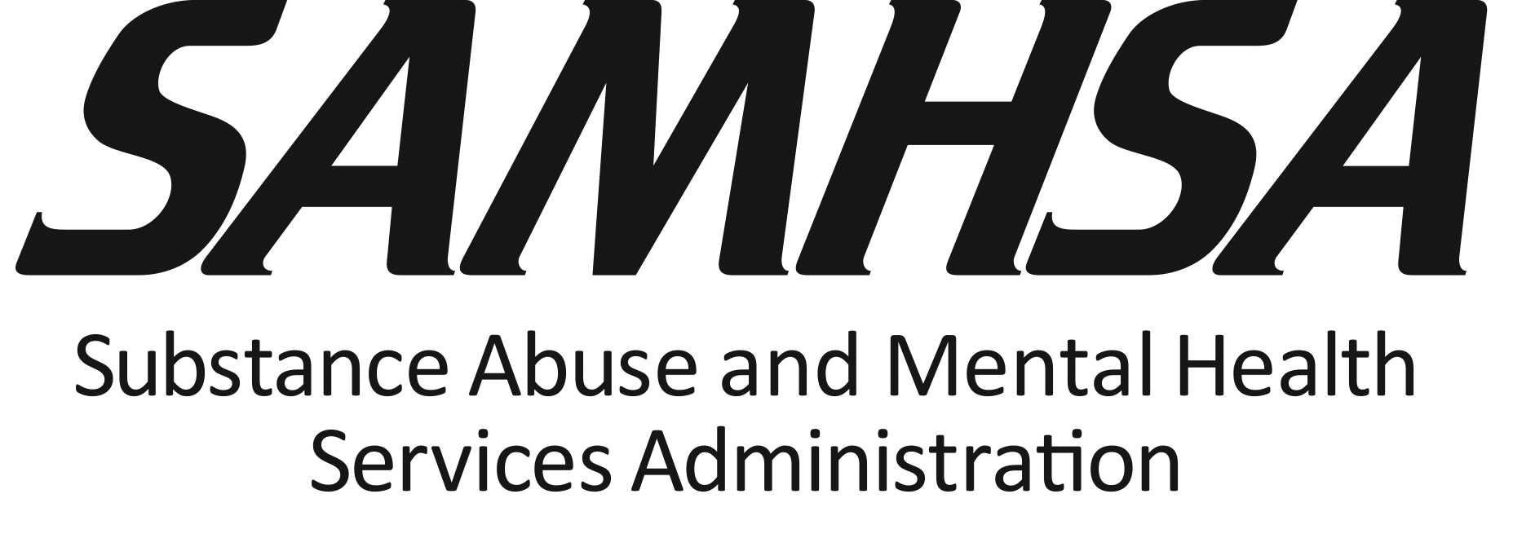
Substance Abuse and Mental Health Services Administration (SAMHSA)
35

